Slide 1
Heart Failure Analysis
Presented by –
Group 10:
Ahfaz Abdul, Sai Sushama Nimmagadda, Harish Babu Ramineni

Slide 2
Introduction
Analyzed clinical records of 299 heart failure patients.
Aim: Identify key predictors, trends, and insights to enhance detection and interventions.
Features: Age, serum creatinine, ejection fraction, lifestyle factors, and more.

Slide 3
Data
Source: Heart Failure Clinical Records Dataset.
Features Collected:
Clinical (e.g., serum creatinine, ejection fraction).
Demographic (e.g., age, sex).
Lifestyle (e.g., smoking, diabetes).

Slide 4
Methods
Data Preprocessing:
Handled missing and negative values, scaled features, and engineered a Total column.
Clustering:
Used KMeans, Agglomerative Clustering, and DBSCAN to group patients.
Exploratory Data Analysis (EDA):
Visualized trends (e.g., age distribution, correlations).
Regression Analysis:
Applied OLS, Lasso, Ridge, and ElasticNet to identify key predictors.

Slide 5
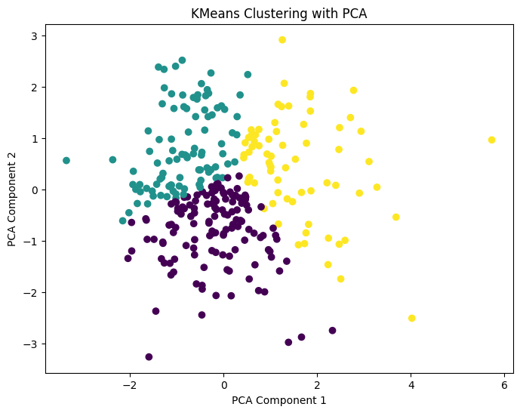
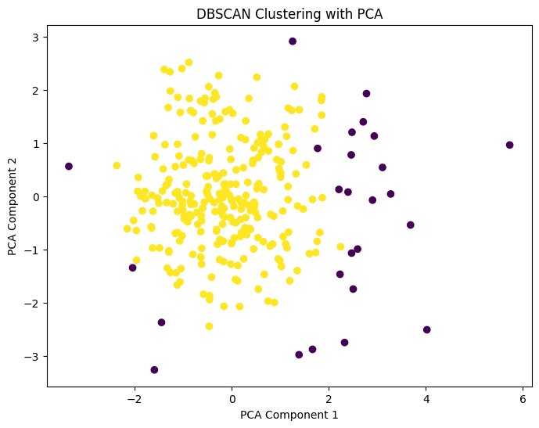
Clustering

Slide 6
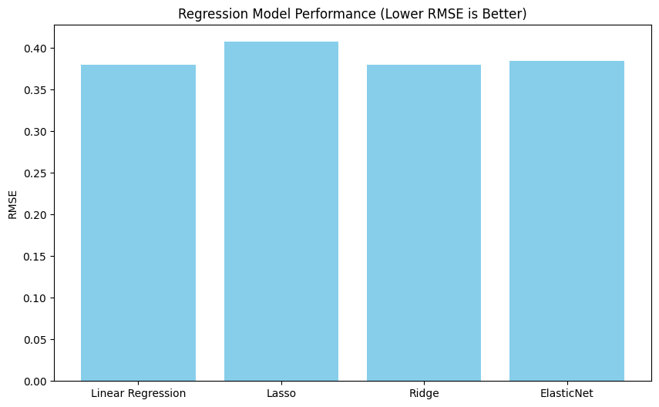
Which model did better?

Slide 7
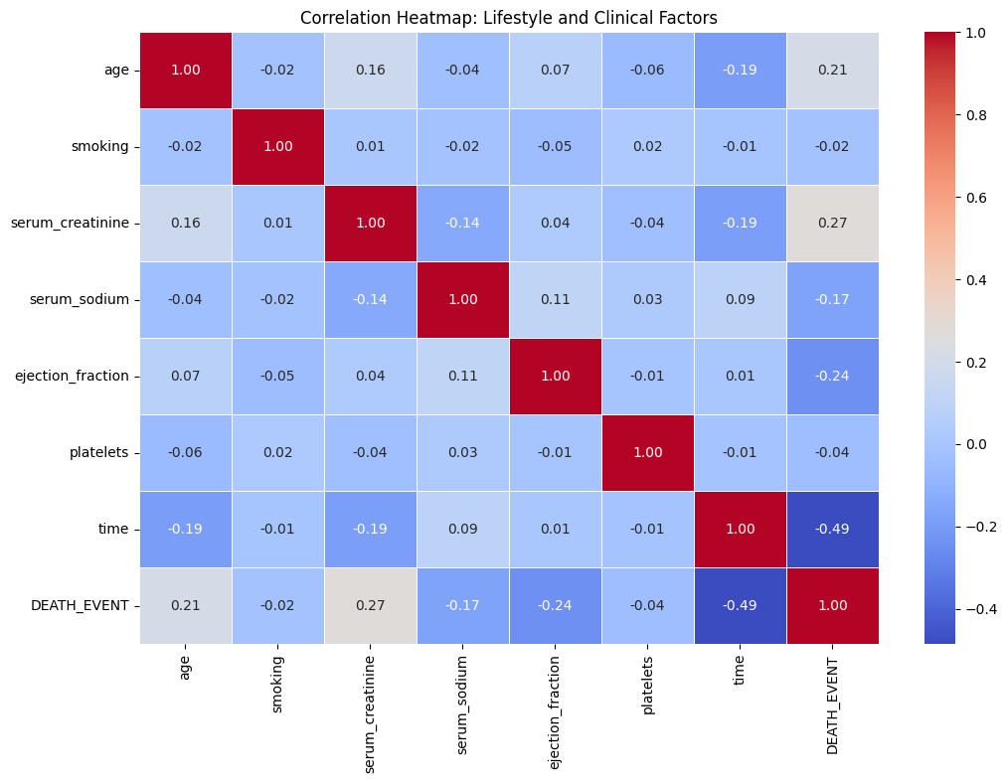
What is the correlation between features?

Slide 8
Key Results
Predictors of Heart Failure:
Serum creatinine, ejection fraction, and follow-up time are critical.
Clustering Insights:
KMeans revealed distinct patient clusters, while DBSCAN identified outliers.
Visualization Highlights:
Age, smoking, and diabetes showed varying impacts on outcomes.

Slide 9
Discussion:
If generalized, results imply that focusing on key predictors like serum creatinine and ejection fraction can guide early detection and interventions.
Limitations: Confounding variables and dataset scope require further validation.

Slide 10
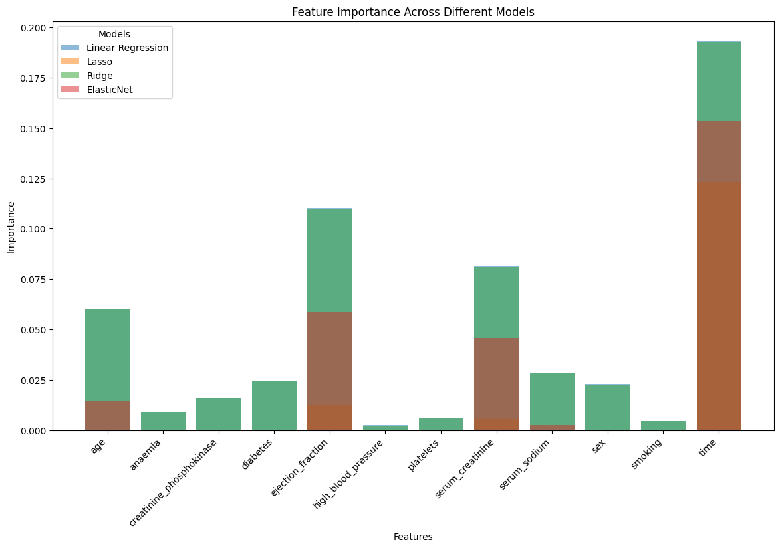
Conclusion:
Serum creatinine and ejection fraction are top predictors.

